Slide 1



Incremental Discovery of Prominent Situational Facts
Afroza Sultana¹, Naeemul Hassan¹, Chengkai Li¹, Jun Yang², Cong Yu³
¹University of Texas at Arlington, ²Duke University, ³Google Research
ICDE 2014, Chicago, IL
Notes:
Hi, I’m Afroza Sultana; going to present our paper.
This is a join work with Naeemul Hassan, Chengkai Li, Jun Yang and Cong Yu.
Let’s see some prominent situational facts.

Slide 2
Situational Facts
“Paul George had 21 points, 11 rebounds and 5 assists to become the first Pacers player with a 20/10/5 (points/rebounds/assists) game against the Bulls since Detlef Schrempf in December 1992.”
(http://espn.go.com/espn/elias?date=20130205)
Notes:
If we consider the whole NBA history under all kinds of performances, then this statement is not that much interesting.

Slide 3
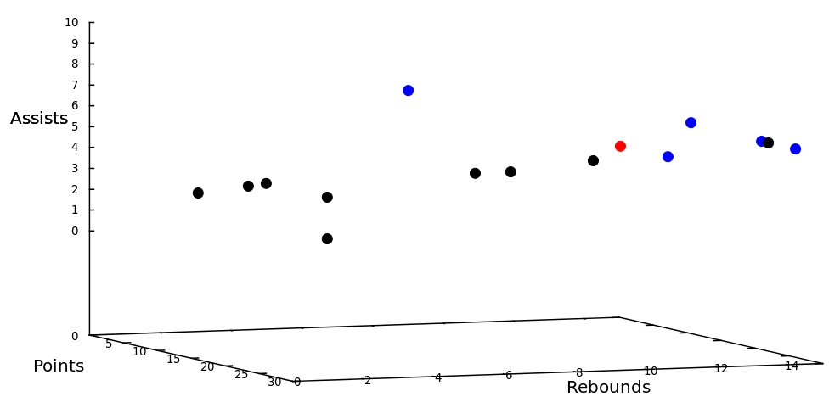
Situational Facts
“Paul George had 21 points, 11 rebounds and 5 assists to become the first Pacers player with a 20/10/5 (points/rebounds/assists) game against the Bulls since Detlef Schrempf in December 1992.”
(http://espn.go.com/espn/elias?date=20130205)
Notes:
Let consider the performance measures points, rebounds and assists only. Let plot all performances on these three measures in NBA history. The red point denotes this performance. Comparing two points t and t′, t′ dominates t if t′ is better than or equal to t on every attribute and better than t on at least one attribute. We can see some blue points, each of them is not dominated by any other point. These are called skyline points and considered as interesting. Other than blue ones, each point is dominated by at least one point. Here, the red point is dominated by some other points, so it doesn’t belong to skyline.

Slide 4
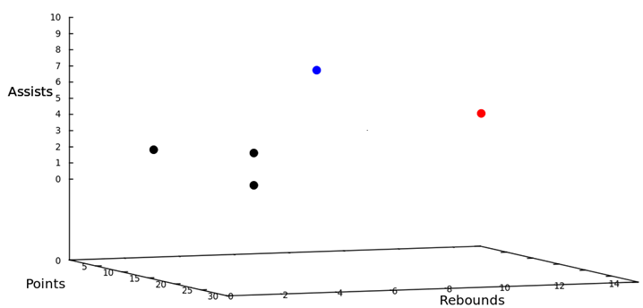
Situational Facts
“Paul George had 21 points, 11 rebounds and 5 assists to become the first Pacers player with a 20/10/5 (points/rebounds/assists) game against the Bulls since Detlef Schrempf in December 1992.”
(http://espn.go.com/espn/elias?date=20130205)
Notes:
But considering the context as the performance of Pacers players in games against the Bulls since December 1992, we can see four points. Other points are gone as they don’t belong to this context. Now there is no other point that dominates the red one. So, it’s in the skyline now and considered as interesting.
Let see another statement.

Slide 5
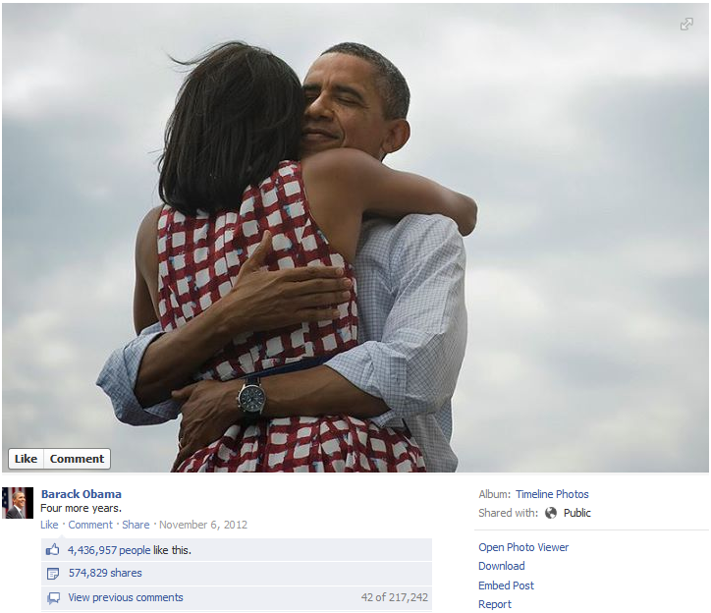
Situational Facts
“The social world’s most viral photo ever generated 3.5 million likes, 170,000 comments and 460,000 shares by Wednesday afternoon.”
(http://www.cnbc.com/id/49728455/President Obama Sets New Social Media Record)

Slide 6
Situational Facts
“The social world’s most viral photo ever generated 3.5 million likes, 170,000 comments and 460,000 shares by Wednesday afternoon.”
(http://www.cnbc.com/id/49728455/President Obama Sets New Social Media Record)
Notes:
Considering the measures likes, comments and share

Slide 7
Situational Facts
“The social world’s most viral photo ever generated 3.5 million likes, 170,000 comments and 460,000 shares by Wednesday afternoon.”
(http://www.cnbc.com/id/49728455/President Obama Sets New Social Media Record)
Notes:
and context as all photos posted to Facebook, no other photo attracted more attention than this photo of President Barack Obama.

Slide 8
Situational Facts
Stock Data: Stock A becomes the first stock in history with price over $300 and market cap over $400 billion.
Weather Data: Today’s measures of wind speed and humidity are x and y, respectively. City B has never encountered such high wind speed and humidity in March.
Criminal Records: There were 50 DUI arrests and 20 collisions in city C yesterday, the first time in 2013.
Financial Analyst
Journalists
Scientists
Citizens
Notes:
Other than sports and social media, we can extract similar statements on data from domains including stock data, weather data and criminal records.
We can see such statements here. I am not going to read them.
Besides journalists, these facts are interesting to financial analyst, scientists and citizens.
Our work is on computational journalism that incorporates computer science with journalism. One of the goals in computational journalism is newsworthy fact discovery. Reporters eventually look for factual statements backed by data. Those statements can be of different forms. We’ve considered this common one.
Let’s relate these statements with database.

Slide 9
A Mini-world of Basketball Gamelogs
id | player | day | month | season | team | opp_team | pts | ast | reb
t₁ | Bogues | 11 | Feb. | 1991-92 | Hornets | Hawks | 4 | 12 | 5
t₂ | Seikaly | 13 | Feb. | 1991-92 | Heat | Hawks | 24 | 5 | 15
t₃ | Sherman | 7 | Dec. | 1993-94 | Celtics | Nets | 13 | 13 | 5
t₄ | Wesley | 4 | Feb. | 1994-95 | Celtics | Nets | 2 | 5 | 2
t₅ | Wesley | 5 | Feb. | 1994-95 | Celtics | Timberwolves | 3 | 5 | 3
t₆ | Strictland | 3 | Jan. | 1995-96 | Blazers | Celtics | 27 | 18 | 8
t₇ | Wesley | 25 | Feb. | 1995-96 | Celtics | Nets | 12 | 13 | 5
Last tuple appended to table
Notes:
Here is a mini-world of basketball gamelogs. It has three performance measures: point, assist and rebound. We have six dimension attributes: player, day, month, season, team and opponent team. There are six existing tuples and t₇ is the new tuple. Our goal is to find out whether t₇ can bring out similar interesting statements.

Slide 10
A Mini-world of Basketball Gamelogs
id | player | day | month | season | team | opp_team | pts | ast | reb
t₁ | Bogues | 11 | Feb. | 1991-92 | Hornets | Hawks | 4 | 12 | 5
t₂ | Seikaly | 13 | Feb. | 1991-92 | Heat | Hawks | 24 | 5 | 15
t₃ | Sherman | 7 | Dec. | 1993-94 | Celtics | Nets | 13 | 13 | 5
t₄ | Wesley | 4 | Feb. | 1994-95 | Celtics | Nets | 2 | 5 | 2
t₅ | Wesley | 5 | Feb. | 1994-95 | Celtics | Timberwolves | 3 | 5 | 3
t₆ | Strictland | 3 | Jan. | 1995-96 | Blazers | Celtics | 27 | 18 | 8
t₇ | Wesley | 25 | Feb. | 1995-96 | Celtics | Nets | 12 | 13 | 5
Notes:
Considering the whole scenario, the skyline tuples are t₂, t₃ and t₆. t₇ is dominated by both t₃ and t₆.

Slide 11
A Mini-world of Basketball Gamelogs
id | player | day | month | season | team | opp_team | pts | ast | reb
t₁ | Bogues | 11 | Feb. | 1991-92 | Hornets | Hawks | 4 | 12 | 5
t₂ | Seikaly | 13 | Feb. | 1991-92 | Heat | Hawks | 24 | 5 | 15
t₃ | Sherman | 7 | Dec. | 1993-94 | Celtics | Nets | 13 | 13 | 5
t₄ | Wesley | 4 | Feb. | 1994-95 | Celtics | Nets | 2 | 5 | 2
t₅ | Wesley | 5 | Feb. | 1994-95 | Celtics | Timberwolves | 3 | 5 | 3
t₆ | Strictland | 3 | Jan. | 1995-96 | Blazers | Celtics | 27 | 18 | 8
t₇ | Wesley | 25 | Feb. | 1995-96 | Celtics | Nets | 12 | 13 | 5
Notes:
But if we only focus on the condition month=Feb, then t₇ isn’t dominated by any tuple.

Slide 12
A Mini-world of Basketball Gamelogs
id | player | day | month | season | team | opp_team | pts | ast | reb
t₁ | Bogues | 11 | Feb. | 1991-92 | Hornets | Hawks | 4 | 12 | 5
t₂ | Seikaly | 13 | Feb. | 1991-92 | Heat | Hawks | 24 | 5 | 15
t₃ | Sherman | 7 | Dec. | 1993-94 | Celtics | Nets | 13 | 13 | 5
t₄ | Wesley | 4 | Feb. | 1994-95 | Celtics | Nets | 2 | 5 | 2
t₅ | Wesley | 5 | Feb. | 1994-95 | Celtics | Timberwolves | 3 | 5 | 3
t₆ | Strictland | 3 | Jan. | 1995-96 | Blazers | Celtics | 27 | 18 | 8
t₇ | Wesley | 25 | Feb. | 1995-96 | Celtics | Nets | 12 | 13 | 5
Wesley had 12 points, 13 assists and 5 rebounds on February 25, 1996 to become the first player with a 12/13/5 (points/assists/rebounds) in February.
Notes:
And t₁ is removed from skyline as it’s dominated by t₇. We can say that under the constraint month=Feb over measure space {point, assist, rebound}, t₇ belongs to the skyline.
We can state “Wesley had 12 points, 13 assists and 5 rebounds on February 25, 1996 to become the first player with a 12/13/5 (points/assists/rebounds) in February..”

Slide 13
A Mini-world of Basketball Gamelogs
id | player | day | month | season | team | opp_team | pts | ast | reb
t₁ | Bogues | 11 | Feb. | 1991-92 | Hornets | Hawks | 4 | 12 | 5
t₂ | Seikaly | 13 | Feb. | 1991-92 | Heat | Hawks | 24 | 5 | 15
t₃ | Sherman | 7 | Dec. | 1993-94 | Celtics | Nets | 13 | 13 | 5
t₄ | Wesley | 4 | Feb. | 1994-95 | Celtics | Nets | 2 | 5 | 2
t₅ | Wesley | 5 | Feb. | 1994-95 | Celtics | Timberwolves | 3 | 5 | 3
t₆ | Strictland | 3 | Jan. | 1995-96 | Blazers | Celtics | 27 | 18 | 8
t₇ | Wesley | 25 | Feb. | 1995-96 | Celtics | Nets | 12 | 13 | 5
Notes:
But if only focus on the condition season=1995-96, then t₇ is dominated by t₆. So, t₇ isn’t in skyline here.

Slide 14
A Mini-world of Basketball Gamelogs
id | player | day | month | season | team | opp_team | pts | ast | reb
t₁ | Bogues | 11 | Feb. | 1991-92 | Hornets | Hawks | 4 | 12 | 5
t₂ | Seikaly | 13 | Feb. | 1991-92 | Heat | Hawks | 24 | 5 | 15
t₃ | Sherman | 7 | Dec. | 1993-94 | Celtics | Nets | 13 | 13 | 5
t₄ | Wesley | 4 | Feb. | 1994-95 | Celtics | Nets | 2 | 5 | 2
t₅ | Wesley | 5 | Feb. | 1994-95 | Celtics | Timberwolves | 3 | 5 | 3
t₆ | Strictland | 3 | Jan. | 1995-96 | Blazers | Celtics | 27 | 18 | 8
t₇ | Wesley | 25 | Feb. | 1995-96 | Celtics | Nets | 12 | 13 | 5
Wesley had 13 assists and 5 rebounds on February 25, 1996 to become the second Celtics player with a 13/5 (assists/rebounds) game against the Nets.
Notes:
Again, we can state “Wesley had 13 assists and 5 rebounds on February 25, 1996 to become the second Celtics player with a 13/5 (assists/rebounds) game against the Nets.”

Slide 15
Problem Definition
Dimension space: D={d₁,… ,d_{n}}
Measure space: M ={m₁,… ,m_{s}}
id | player | day | month | season | team | opp_team | pts | ast | reb
t₁ | Bogues | 11 | Feb. | 1991-92 | Hornets | Hawks | 4 | 12 | 5
t₂ | Seikaly | 13 | Feb. | 1991-92 | Heat | Hawks | 24 | 5 | 15
t₃ | Sherman | 7 | Dec. | 1993-94 | Celtics | Nets | 13 | 13 | 5
t₄ | Wesley | 4 | Feb. | 1994-95 | Celtics | Nets | 2 | 5 | 2
t₅ | Wesley | 5 | Feb. | 1994-95 | Celtics | Timberwolves | 3 | 5 | 3
t₆ | Strictland | 3 | Jan. | 1995-96 | Blazers | Celtics | 27 | 18 | 8
append-only table
Notes:
Let’s come to our problem definition. We have an append-only table. It has dimension space consists of dimension attributes. In this scenario: player, day, month, season, team opponent team. And measure space consists of measure attributes. For this case: point, assist, rebound.

Slide 16
Problem Definition
Constraint (C): d₁=v₁∧d₂=v₂∧. . . ∧ d_{n}=v_{n}, v_{i}∈dom(d_{i})∪{∗}
team=Celtics ∧ opp_team=Nets
id | player | day | month | season | team | opp_team | pts | ast | rb
t₁ | Bogues | 11 | Feb. | 1991-92 | Hornets | Hawks | 4 | 12 | 5
t₂ | Seikaly | 13 | Feb. | 1991-92 | Heat | Hawks | 24 | 5 | 15
t₃ | Sherman | 7 | Dec. | 1993-94 | Celtics | Nets | 13 | 13 | 5
t₄ | Wesley | 4 | Feb. | 1994-95 | Celtics | Nets | 2 | 5 | 2
t₅ | Wesley | 5 | Feb. | 1994-95 | Celtics | Timberwolves | 3 | 5 | 3
t₆ | Strictland | 3 | Jan. | 1995-96 | Blazers | Celtics | 27 | 18 | 8
Notes:
A constraint on dimension space is conjunctive expression of this form. Here, ‘team=Celtics&opp_team=Nets’ is a constraint. Under this constraints, we can see two tuples: t₃ and t₄.

Slide 17
Problem Definition
Constraint-Measure Pair (C, M): Combination of a constraint and measure subspace
(team=Celtics ∧ opp_team=Nets,{assists,rebounds})
id | player | day | month | season | team | opp_team | pts | ast | reb
t₁ | Bogues | 11 | Feb. | 1991-92 | Hornets | Hawks | 4 | 12 | 5
t₂ | Seikaly | 13 | Feb. | 1991-92 | Heat | Hawks | 24 | 5 | 15
t₃ | Sherman | 7 | Dec. | 1993-94 | Celtics | Nets | 13 | 13 | 5
t₄ | Wesley | 4 | Feb. | 1994-95 | Celtics | Nets | 2 | 5 | 2
t₅ | Wesley | 5 | Feb. | 1994-95 | Celtics | Timberwolves | 3 | 5 | 3
t₆ | Strictland | 3 | Jan. | 1995-96 | Blazers | Celtics | 27 | 18 | 8
Notes:
A constraint-measure pair is a combination of a constraint and measure subspace. Here, constraint ‘team=Celtics&opp_team=Nets’ and measure subspace {assist, rebound}; together they form a constraint-measure pair.

Slide 18
Problem Definition
Contextual skyline: skyline regarding (C, M)
σ_{team=Celtics ∧ opp_team=Nets}(R), M={assists,rebounds}
{t₃}
id | player | day | month | season | team | opp_team | pts | ast | reb
t₁ | Bogues | 11 | Feb. | 1991-92 | Hornets | Hawks | 4 | 12 | 5
t₂ | Seikaly | 13 | Feb. | 1991-92 | Heat | Hawks | 24 | 5 | 15
t₃ | Sherman | 7 | Dec. | 1993-94 | Celtics | Nets | 13 | 13 | 5
t₄ | Wesley | 4 | Feb. | 1994-95 | Celtics | Nets | 2 | 5 | 2
t₅ | Wesley | 5 | Feb. | 1994-95 | Celtics | Timberwolves | 3 | 5 | 3
t₆ | Strictland | 3 | Jan. | 1995-96 | Blazers | Celtics | 27 | 18 | 8
Notes:
Contextual skyline is skyline regarding a constraint-measure pair. For this case, the contextual skyline have t₃.

Slide 19
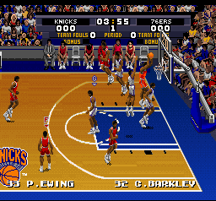
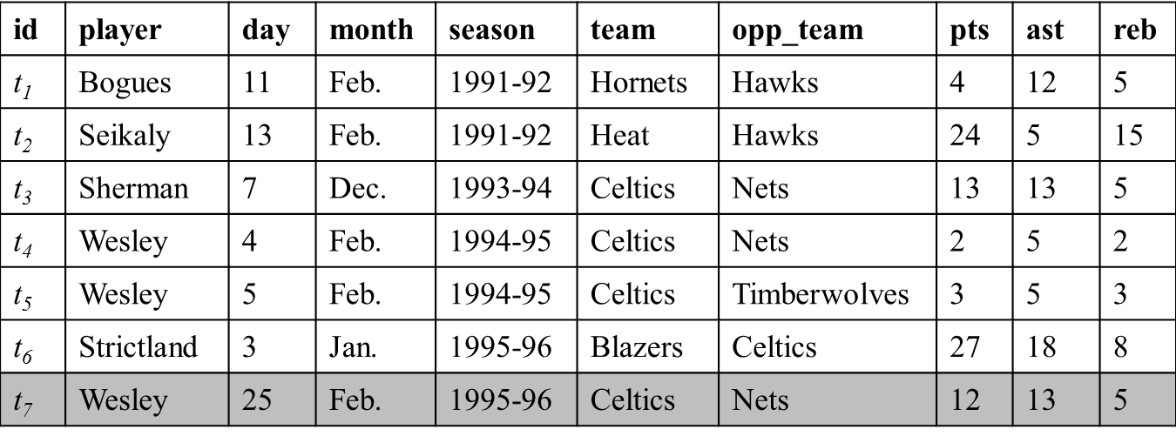
Problem Definition; Situational Fact Discover Problem
Tuples capturing real world events appended to table
Find constraint-measure pair (C,M) such that t is in the contextual skyline.
Constraint | Measure
month=Feb | pts, ast, rb
opp_team=Nets | ast, rb
team=Celtics ∧ opp_team=Nets | ast, rb
… | …
Template
Wesley had 12 points, 13 assists and 5 rebounds on February 25, 1996 to become the first player with a 12/13/5 (points/assists/rebounds) in February.
Notes:
Let’s think about a real world event. Tuples capturing the events are appended to a database. So, our Situational Fact Discover Problem is finding constraint-measure pairs where the last tuple belongs to the contextual skylines. These are the constraint-measure pairs, where t₇ belongs to contextual skylines. Then using templates, news statements are brought out.

Slide 20
Related Work
Conventional skyline analysis (Borzsonyi et al. ICDE 2001)
Q: context, measure subspace A: contextual skyline tuples
Our focus--- A: tuple Q: constraint-measure pairs
Notes:
Let’s go through some related works. So far, conventional skyline analysis is “Given a question (a context, a measure subspace), find answers---contextual skyline tuples.” But our focus is “Given an append-only table and a new tuple, find questions (constraints and measure subspaces that qualify the tuple as a contextual skyline tuple).”

Slide 21
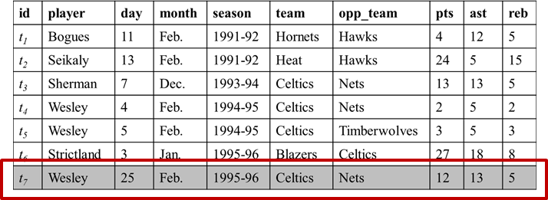
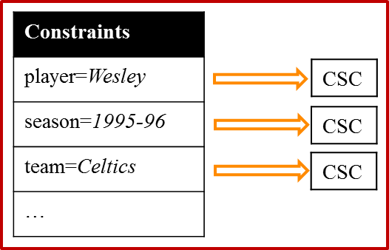
Related Works
Compressed Skycube (Xia et al. SIGMOD 2006)
Update compressed skycube in monitoring fashion
We adapted CSC for each constraint: Constraint-CSC
Constraint | Measure
month=Feb | pts, ast, rb
opp_team=Nets | ast, rb
team=Celtics ∧ opp_team=Nets | ast, rb
… | …
Query
Notes:
There is a work on Compressed Skycube that’s updating compressed skycube in monitoring fashion. We adapted compressed skycube for each constraint and named it constrained compressed skycube. We’ve compared this with our methods. I’ll show it in experiment result.

Slide 22
Related Works
Prominent Analysis by Ranking (Wu et. Al. VLDB 2009)
Static data, onetime query
We dealt on continuous data, standing query
Find the contexts where an object is ranked high in a single scoring attribute
We considered skyline on multiple measure subspaces
Notes:
There is another work on Prominent Analysis by Ranking. They used static data and onetime query. But we dealt on continuous data and standing query. They dealt on finding the contexts where an object is ranked high in a single score attribute. We considered skyline on multiple measure subspaces.

Slide 23
Modeling
Τ
{t₂,t₃,t₄,t₅}
id | d₁ | d₂ | d₃ | m₁ | m₂
t₁ | a₁ | b₂ | c₂ | 10 | 15
t₂ | a₁ | b₁ | c₁ | 15 | 10
t₃ | a₂ | b₁ | c₂ | 17 | 17
t₄ | a₂ | b₁ | c₁ | 20 | 20
t₅ | a₁ | b₁ | c₁ | 11 | 15
a₁
{t₁,t₂,t₅}
b₁
{t₂,t₃,t₄,t₅}
c₁
{t₂,t₄,t₅}
a₁,b₁
{t₂,t₅}
a₁,c₁
{t₂,t₅}
b₁,c₁
{t₂,t₄,t₅}
a₁,b₁,c₁
{t₂,t₅}
d₁=a₁ ∧ d₂=b₁ ∧ d₃=c₁
Lattice of C ^{t5}
Tuple Satisfied Constraint C ^{t} : If ∀d_{i}∈D, C.d_{i}=∗ or C.d_{i}=t.d_{i}, t satisfies C.
Notes:
Let’s come to modeling. I’m discussing this because I need this to elaborate our algorithms. We can see a running example of 3 dimensions and 2 measures. There are 4 existing tuples and t₅ is the new entry. Constraint satisfying a tuple is called tuple satisfied constraint and all such constraints can form a lattice as there are subsumption relationship among them. We can see the lattice of C ^{t5} here. Tuples satisfied by each constraint are shown. The bottom-most constraint a1b1c1 is actually shorter representation of the constraint d₁=a₁ ∧ d₂=b₁ ∧ d₃=c₁. a1b1c1 is subsumed by b1c1, that means tuples satisfied by a1b1c1 are also satisfied by b1c1.

Slide 24
Modeling
Lattice of C ^{t4}
Τ
id | d₁ | d₂ | d₃ | m₁ | m₂
t₁ | a₁ | b₂ | c₂ | 10 | 15
t₂ | a₁ | b₁ | c₁ | 15 | 10
t₃ | a₂ | b₁ | c₂ | 17 | 17
t₄ | a₂ | b₁ | c₁ | 20 | 20
t₅ | a₁ | b₁ | c₁ | 11 | 15
a₁
a₂
b₁
c₁
a₁,b₁
a₂,b₁
a₁,c₁
a₂,c₁
b₁,c₁
a₁,b₁,c₁
a₂,b₁,c₁
Lattice of C ^{t5}
Notes:
Let’s represent the lattice like this.
If we compare t₄ with t₅, we can see common values in 2 dimensions. Now adapt the lattice of C ^{t4} on it.

Slide 25
Modeling
Lattice of C ^{t4}
Τ
id | d₁ | d₂ | d₃ | m₁ | m₂
t₁ | a₁ | b₂ | c₂ | 10 | 15
t₂ | a₁ | b₁ | c₁ | 15 | 10
t₃ | a₂ | b₁ | c₂ | 17 | 17
t₄ | a₂ | b₁ | c₁ | 20 | 20
t₅ | a₁ | b₁ | c₁ | 11 | 15
a₁
a₂
b₁
c₁
a₁,b₁
a₂,b₁
a₁,c₁
a₂,c₁
b₁,c₁
a₁,b₁,c₁
a₂,b₁,c₁
Lattice of C ^{t5}
Lattice Intersection: C ^{t4,t5}=C ^{t4}∩C ^{t5}
Notes:
Because of those common values, there are common constraints in this lattice intersection represented by black solid lines.
Now that you have seen problem definition and how we model it, let's see some interesting ways to solve this problem.

Slide 26
Brute-Force Approach
Τ
id | d₁ | d₂ | d₃ | m₁ | m₂
t₁ | a₁ | b₂ | c₂ | 10 | 15
t₂ | a₁ | b₁ | c₁ | 15 | 10
t₃ | a₂ | b₁ | c₂ | 17 | 17
t₄ | a₂ | b₁ | c₁ | 20 | 20
t₅ | a₁ | b₁ | c₁ | 11 | 15
a₁
b₁
c₁
a₁,b₁
a₁,c₁
b₁,c₁
a₁,b₁,c₁
Notes:
In the brute-force approach, the new tuple is compare with each existing tuple under each common constraints over each measure subspace. I’m showing only for full space {m₁,m₂}.

Slide 27
Brute-Force Approach
Τ
id | d₁ | d₂ | d₃ | m₁ | m₂
t₁ | a₁ | b₂ | c₂ | 10 | 15
t₂ | a₁ | b₁ | c₁ | 15 | 10
t₃ | a₂ | b₁ | c₂ | 17 | 17
t₄ | a₂ | b₁ | c₁ | 20 | 20
t₅ | a₁ | b₁ | c₁ | 11 | 15
a₁
b₁
c₁
a₁,b₁
a₁,c₁
b₁,c₁
a₁,b₁,c₁
Notes:
At first, t₅ will be compared with t₁. Here, the common constraints are top and a₁. t₅ isn’t dominated here.

Slide 28
Brute-Force Approach
Τ
id | d₁ | d₂ | d₃ | m₁ | m₂
t₁ | a₁ | b₂ | c₂ | 10 | 15
t₂ | a₁ | b₁ | c₁ | 15 | 10
t₃ | a₂ | b₁ | c₂ | 17 | 17
t₄ | a₂ | b₁ | c₁ | 20 | 20
t₅ | a₁ | b₁ | c₁ | 11 | 15
a₁
b₁
c₁
a₁,b₁
a₁,c₁
b₁,c₁
a₁,b₁,c₁
Notes:
Similarly, t₅ will be compared with t₂.

Slide 29
Brute-Force Approach
Τ
id | d₁ | d₂ | d₃ | m₁ | m₂
t₁ | a₁ | b₂ | c₂ | 10 | 15
t₂ | a₁ | b₁ | c₁ | 15 | 10
t₃ | a₂ | b₁ | c₂ | 17 | 17
t₄ | a₂ | b₁ | c₁ | 20 | 20
t₅ | a₁ | b₁ | c₁ | 11 | 15
a₁
b₁
c₁
a₁,b₁
a₁,c₁
b₁,c₁
a₁,b₁,c₁
Notes:
While comparing with t₃, we get that t₅ is dominated by t₃; so t₅ doesn’t belong to the contextual skylines of their common constraints.

Slide 30
Brute-Force Approach
Τ
id | d₁ | d₂ | d₃ | m₁ | m₂
t₁ | a₁ | b₂ | c₂ | 10 | 15
t₂ | a₁ | b₁ | c₁ | 15 | 10
t₃ | a₂ | b₁ | c₂ | 17 | 17
t₄ | a₂ | b₁ | c₁ | 20 | 20
t₅ | a₁ | b₁ | c₁ | 11 | 15
a₁
b₁
c₁
a₁,b₁
a₁,c₁
b₁,c₁
a₁,b₁,c₁

Slide 31
Brute-Force Approach
Τ
id | d₁ | d₂ | d₃ | m₁ | m₂
t₁ | a₁ | b₂ | c₂ | 10 | 15
t₂ | a₁ | b₁ | c₁ | 15 | 10
t₃ | a₂ | b₁ | c₂ | 17 | 17
t₄ | a₂ | b₁ | c₁ | 20 | 20
t₅ | a₁ | b₁ | c₁ | 11 | 15
a₁
b₁
c₁
a₁,b₁
a₁,c₁
b₁,c₁
a₁,b₁,c₁
Notes:
Similarly, t₅ is dominated by t₄; t₅ doesn’t belong to the contextual skylines of these two constraints also. This is the final state after the comparison over full space {m₁,m₂}. t₅ belongs to contextual skylines of these four constraints.

Slide 32
Brute-Force Approach
Τ
id | d₁ | d₂ | d₃ | m₁ | m₂
t₁ | a₁ | b₂ | c₂ | 10 | 15
t₂ | a₁ | b₁ | c₁ | 15 | 10
t₃ | a₂ | b₁ | c₂ | 17 | 17
t₄ | a₂ | b₁ | c₁ | 20 | 20
t₅ | a₁ | b₁ | c₁ | 11 | 15
a₁
b₁
c₁
a₁,b₁
a₁,c₁
b₁,c₁
a₁,b₁,c₁
Total |R|*(2^{|D|+|M|}-1) comparisons!
Total 16 comparisons in this case!
Notes:
The total number of comparison here is the size of the table multiply by size of the lattice and the number of measure subspaces. For this example, it’s 16.

Slide 33
Challenges
Exhaustive comparison with every tuple
Under every constraint
Over every measure subspace
Notes:
So, the challenges here are:
Exhaustive comparison with every tuple
Under every constraint
Over every measure subspace
Let’s see how we can tackle these challenges.

Slide 34
Challenges and Ideas
Exhaustive comparison with every tuple
Tuple reduction
Comparison with skyline tuples is enough
t₄≻_{{m1,m2}}t₃≻_{{m1,m2}}t₅ => t₄≻_{{m1,m2}}t₅
id | d₁ | d₂ | d₃ | m₁ | m₂
t₁ | a₁ | b₂ | c₂ | 10 | 15
t₂ | a₁ | b₁ | c₁ | 15 | 10
t₃ | a₂ | b₁ | c₂ | 17 | 17
t₄ | a₂ | b₁ | c₁ | 20 | 20
t₅ | a₁ | b₁ | c₁ | 11 | 15
Notes:
To tackle the 1st challenge the idea is Tuple Reduction that we need to compare with skyline tuples only.
Consider the running example under the context d₂=b₁. There are two non-skyline and one skyline tuples. Here, t₄ dominates t₃ and t₃ dominates t₅. According to transitivity, t₄ dominates t₅. So, comparing with t₄ is enough. We don’t need to compare with t₃ separately.

Slide 35
Challenges and Ideas
Under every constraint
Constraint pruning
In C ^{t,t'}, one comparison on t and t' is enough
Τ
id | d₁ | d₂ | d₃ | m₁ | m₂
t₁ | a₁ | b₂ | c₂ | 10 | 15
t₂ | a₁ | b₁ | c₁ | 15 | 10
t₃ | a₂ | b₁ | c₂ | 17 | 17
t₄ | a₂ | b₁ | c₁ | 20 | 20
t₅ | a₁ | b₁ | c₁ | 11 | 15
a₁
b₁
c₁
a₁,b₁
a₁,c₁
b₁,c₁
a₁,b₁,c₁
Notes:
To tackle the 2nd challenge the idea is Constraint Pruning.
Let’s look through the tuples t₄ and t₅. We can see that t₄ dominates t₅ and they have common values on 2 dimensions. So, they share these 4 constraints.
As they share 4 constraints, we don’t need to compare 4 times separately. Based on only 1 comparison, we can skip comparisons for other constraints.

Slide 36
Challenges and Ideas
Under every constraint
Constraint pruning
In C ^{t,t'}, one comparison on t and t' is enough
Τ
id | d₁ | d₂ | d₃ | m₁ | m₂
t₁ | a₁ | b₂ | c₂ | 10 | 15
t₂ | a₁ | b₁ | c₁ | 15 | 10
t₃ | a₂ | b₁ | c₂ | 17 | 17
t₄ | a₂ | b₁ | c₁ | 20 | 20
t₅ | a₁ | b₁ | c₁ | 11 | 15
a₁
b₁
c₁
a₁,b₁
a₁,c₁
b₁,c₁
a₁,b₁,c₁

Slide 37
Challenges and Ideas
Over every measure subspace
Sharing computation across measure subspaces
Reusing computations on full space in subspaces
Τ
id | d₁ | d₂ | d₃ | m₁ | m₂
t₁ | a₁ | b₂ | c₂ | 10 | 15
t₂ | a₁ | b₁ | c₁ | 15 | 10
t₃ | a₂ | b₁ | c₂ | 17 | 17
t₄ | a₂ | b₁ | c₁ | 20 | 20
t₅ | a₁ | b₁ | c₁ | 11 | 15
a₁
b₁
c₁
a₁,b₁
a₁,c₁
b₁,c₁
a₁,b₁,c₁
Notes:
To avoid computation over every measure subspace, we can reuse computations on full space on subspaces. While comparing with t₂, we get that though they are incomparable the value of t₂ is greater than t₅ in attribute m₁. So, t₂ will dominate t₅ in subspace {m₁} and we get that t₅ will not be in contextual skyline for the common constraints.

Slide 38
Challenges and Ideas
Over every measure subspace
Sharing computation across measure subspaces
Reusing computations on full space in subspaces
Τ
id | d₁ | d₂ | d₃ | m₁ | m₂
t₁ | a₁ | b₂ | c₂ | 10 | 15
t₂ | a₁ | b₁ | c₁ | 15 | 10
t₃ | a₂ | b₁ | c₂ | 17 | 17
t₄ | a₂ | b₁ | c₁ | 20 | 20
t₅ | a₁ | b₁ | c₁ | 11 | 15
a₁
b₁
c₁
a₁,b₁
a₁,c₁
b₁,c₁
a₁,b₁,c₁

Slide 39
Our Algorithms
Tuple reduction + Constraint pruning
BottomUp
TopDown
Tuple reduction + Constraint pruning + Sharing computation
SBottomUp
STopDown
Notes:
We designed several algorithms.
Our algorithms BottomUp and TopDown exploits the idea of Tuple reduction and Constraint pruning. And the algorithms SBottomUp and STopDown exploit sharing computation as well.
Let’s come to BottomUp first.

Slide 40
BottomUp
Stores a tuple for every such constraint that qualifies it as a contextual skyline tuple
Traverses the constraints in C ^{t} in a bottom-up, breadth-first manner
Notes:
BottomUp stores a tuple for every such constraint that qualifies it as a contextual skyline tuple.
It traverses the constraints in C ^{t} in a bottom-up, breadth-first manner.
Let see this through an example.

Slide 41
BottomUp
id | d₁ | d₂ | d₃ | m₁ | m₂
t₁ | a₁ | b₂ | c₂ | 10 | 15
t₂ | a₁ | b₁ | c₁ | 15 | 10
t₃ | a₂ | b₁ | c₂ | 17 | 17
t₄ | a₂ | b₁ | c₁ | 20 | 20
t₅ | a₁ | b₁ | c₁ | 11 | 15
Τ
{t₄}
a₁
{t₁,t₂}
b₁
{t₄}
c₁
{t₄}
a₁,b₁
{t₂}
a₁,c₁
{t₂}
b₁,c₁
{t₄}
a₁,b₁,c₁
{t₂}
Notes:
In the lattice of C ^{t5}, skyline tuples are stored corresponding to each constraints. As the traversal is bottom-up, a₁b₁c₁ is traversed at first.

Slide 42
BottomUp
id | d₁ | d₂ | d₃ | m₁ | m₂
t₁ | a₁ | b₂ | c₂ | 10 | 15
t₂ | a₁ | b₁ | c₁ | 15 | 10
t₃ | a₂ | b₁ | c₂ | 17 | 17
t₄ | a₂ | b₁ | c₁ | 20 | 20
t₅ | a₁ | b₁ | c₁ | 11 | 15
Τ
{t₄}
a₁
{t₁,t₂}
b₁
{t₄}
c₁
{t₄}
a₁,b₁
{t₂}
a₁,c₁
{t₂}
b₁,c₁
{t₄}
a₁,b₁,c₁
{t₂}
Notes:
As t₅ isn’t dominated here, it belongs to the skyline.

Slide 43
BottomUp
id | d₁ | d₂ | d₃ | m₁ | m₂
t₁ | a₁ | b₂ | c₂ | 10 | 15
t₂ | a₁ | b₁ | c₁ | 15 | 10
t₃ | a₂ | b₁ | c₂ | 17 | 17
t₄ | a₂ | b₁ | c₁ | 20 | 20
t₅ | a₁ | b₁ | c₁ | 11 | 15
Τ
{t₄}
a₁
{t₁,t₂}
b₁
{t₄}
c₁
{t₄}
a₁,b₁
{t₂}
a₁,c₁
{t₂}
b₁,c₁
{t₄}
a₁,b₁,c₁
{t_{2,}t₅}

Slide 44
BottomUp
id | d₁ | d₂ | d₃ | m₁ | m₂
t₁ | a₁ | b₂ | c₂ | 10 | 15
t₂ | a₁ | b₁ | c₁ | 15 | 10
t₃ | a₂ | b₁ | c₂ | 17 | 17
t₄ | a₂ | b₁ | c₁ | 20 | 20
t₅ | a₁ | b₁ | c₁ | 11 | 15
Τ
{t₄}
a₁
{t₁,t₂}
b₁
{t₄}
c₁
{t₄}
a₁,b₁
{t₂}
a₁,c₁
{t₂}
b₁,c₁
{t₄}
a₁,b₁,c₁
{t_{2,}t₅}

Slide 45
BottomUp
id | d₁ | d₂ | d₃ | m₁ | m₂
t₁ | a₁ | b₂ | c₂ | 10 | 15
t₂ | a₁ | b₁ | c₁ | 15 | 10
t₃ | a₂ | b₁ | c₂ | 17 | 17
t₄ | a₂ | b₁ | c₁ | 20 | 20
t₅ | a₁ | b₁ | c₁ | 11 | 15
Τ
{t₄}
a₁
{t₁,t₂}
b₁
{t₄}
c₁
{t₄}
a₁,b₁
{t_{2,}t₅}
a₁,c₁
{t_{2,}t₅}
b₁,c₁
{t₄}
a₁,b₁,c₁
{t_{2,}t₅}
Notes:
The it will traverse its parents. Similar thing will happened for a₁b₁ and a₁c₁.

Slide 46
BottomUp
id | d₁ | d₂ | d₃ | m₁ | m₂
t₁ | a₁ | b₂ | c₂ | 10 | 15
t₂ | a₁ | b₁ | c₁ | 15 | 10
t₃ | a₂ | b₁ | c₂ | 17 | 17
t₄ | a₂ | b₁ | c₁ | 20 | 20
t₅ | a₁ | b₁ | c₁ | 11 | 15
Τ
{t₄}
a₁
{t₁,t₂}
b₁
{t₄}
c₁
{t₄}
a₁,b₁
{t_{2,}t₅}
a₁,c₁
{t_{2,}t₅}
b₁,c₁
{t₄}
a₁,b₁,c₁
{t_{2,}t₅}
Notes:
For b₁c₁, t₅ is dominated by t₄. According to constraint pruning, the lattice intersection of t₄ and t₅ is skipped.

Slide 47
BottomUp
id | d₁ | d₂ | d₃ | m₁ | m₂
t₁ | a₁ | b₂ | c₂ | 10 | 15
t₂ | a₁ | b₁ | c₁ | 15 | 10
t₃ | a₂ | b₁ | c₂ | 17 | 17
t₄ | a₂ | b₁ | c₁ | 20 | 20
t₅ | a₁ | b₁ | c₁ | 11 | 15
Τ
{t₄}
a₁
{t₁,t₂}
b₁
{t₄}
c₁
{t₄}
a₁,b₁
{t_{2,}t₅}
a₁,c₁
{t_{2,}t₅}
b₁,c₁
{t₄}
a₁,b₁,c₁
{t_{2,}t₅}
Notes:
Then only a₁ is left.

Slide 48
BottomUp
id | d₁ | d₂ | d₃ | m₁ | m₂
t₁ | a₁ | b₂ | c₂ | 10 | 15
t₂ | a₁ | b₁ | c₁ | 15 | 10
t₃ | a₂ | b₁ | c₂ | 17 | 17
t₄ | a₂ | b₁ | c₁ | 20 | 20
t₅ | a₁ | b₁ | c₁ | 11 | 15
Τ
{t₄}
a₁
{t₁,t₂}
b₁
{t₄}
c₁
{t₄}
a₁,b₁
{t_{2,}t₅}
a₁,c₁
{t_{2,}t₅}
b₁,c₁
{t₄}
a₁,b₁,c₁
{t_{2,}t₅}
Notes:
Here, t₅ is not dominated. So, it’s in the skyline. t₅ dominates t₁, t₁ is removed.

Slide 49
BottomUp
id | d₁ | d₂ | d₃ | m₁ | m₂
t₁ | a₁ | b₂ | c₂ | 10 | 15
t₂ | a₁ | b₁ | c₁ | 15 | 10
t₃ | a₂ | b₁ | c₂ | 17 | 17
t₄ | a₂ | b₁ | c₁ | 20 | 20
t₅ | a₁ | b₁ | c₁ | 11 | 15
Τ
{t₄}
a₁
{t₂,t₅}
b₁
{t₄}
c₁
{t₄}
a₁,b₁
{t_{2,}t₅}
a₁,c₁
{t_{2,}t₅}
b₁,c₁
{t₄}
Total 6 comparisons in this case
a₁,b₁,c₁
{t_{2,}t₅}
Notes:
Here, the total number of comparison is 6, much less than brute-force.

Slide 50
BottomUp
Cons of BottomUp
Repetitive storage: space complexity
Repetitive comparisons: time complexity
TopDown stores a tuple for its maximal skyline constraints only.
Notes:
The problem here are we need to store same tuple repetitively and so the number of comparisons is high.
We’ve another algorithm TopDown. It stores a tuple corresponding to its maximal skyline constraints only. Let’s what it is.

Slide 51
TopDown
Skyline Constraints
Constraints whose contextual skylines include t.
Τ
{t₄}
id | d₁ | d₂ | d₃ | m₁ | m₂
t₁ | a₁ | b₂ | c₂ | 10 | 15
t₂ | a₁ | b₁ | c₁ | 15 | 10
t₃ | a₂ | b₁ | c₂ | 17 | 17
t₄ | a₂ | b₁ | c₁ | 20 | 20
t₅ | a₁ | b₁ | c₁ | 11 | 15
a₁
{t₂,t₅}
b₁
{t₄}
c₁
{t₄}
a₁,b₁
{t_{2,}t₅}
a₁,c₁
{t_{2,}t₅}
b₁,c₁
{t₄}
a₁,b₁,c₁
{t_{2,}t₅}
Notes:
Skyline Constraints are constraints whose contextual skylines include t. The constraints marked in blue are the skyline constraints for t.

Slide 52
TopDown
Maximal Skyline Constraints
Constraints not subsumed by any other skyline constraints of t.
Τ
{t₄}
id | d₁ | d₂ | d₃ | m₁ | m₂
t₁ | a₁ | b₂ | c₂ | 10 | 15
t₂ | a₁ | b₁ | c₁ | 15 | 10
t₃ | a₂ | b₁ | c₂ | 17 | 17
t₄ | a₂ | b₁ | c₁ | 20 | 20
t₅ | a₁ | b₁ | c₁ | 11 | 15
a₁
{t₂,t₅}
b₁
{t₄}
c₁
{t₄}
a₁,b₁
{t_{2,}t₅}
a₁,c₁
{t_{2,}t₅}
b₁,c₁
{t₄}
a₁,b₁,c₁
{t_{2,}t₅}
Notes:
Maximal Skyline Constraints are constraints whose contextual skylines include t. The constraint marked in red is the maximal skyline constraints for t as it is not subsumed by any blue constraint.
AsTopDown stores a tuple only for maximal skyline constraints, the storage representation for this case will be like this…

Slide 53
TopDown
Maximal Skyline Constraints
Constraints not subsumed by any other skyline constraints of t.
Τ
{t₄}
id | d₁ | d₂ | d₃ | m₁ | m₂
t₁ | a₁ | b₂ | c₂ | 10 | 15
t₂ | a₁ | b₁ | c₁ | 15 | 10
t₃ | a₂ | b₁ | c₂ | 17 | 17
t₄ | a₂ | b₁ | c₁ | 20 | 20
t₅ | a₁ | b₁ | c₁ | 11 | 15
a₁
{t₂,t₅}
b₁
{}
c₁
{}
a₁,b₁
{}
a₁,c₁
{}
b₁,c₁
{}
a₁,b₁,c₁
{}
Notes:
Let’s see how TopDown maintain this structure.

Slide 54
TopDown
id | d₁ | d₂ | d₃ | m₁ | m₂
t₁ | a₁ | b₂ | c₂ | 10 | 15
t₂ | a₁ | b₁ | c₁ | 15 | 10
t₃ | a₂ | b₁ | c₂ | 17 | 17
t₄ | a₂ | b₁ | c₁ | 20 | 20
t₅ | a₁ | b₁ | c₁ | 11 | 15
Τ
{t₄}
a₁
{t₁,t₂}
b₁
{}
c₁
{}
a₁,b₁
{}
a₁,c₁
{}
b₁,c₁
{}
a₁,b₁,c₁
{}
Notes:
Here the traversal is top-down, breadth first manner. So, top is traversed first.

Slide 55
TopDown
id | d₁ | d₂ | d₃ | m₁ | m₂
t₁ | a₁ | b₂ | c₂ | 10 | 15
t₂ | a₁ | b₁ | c₁ | 15 | 10
t₃ | a₂ | b₁ | c₂ | 17 | 17
t₄ | a₂ | b₁ | c₁ | 20 | 20
t₅ | a₁ | b₁ | c₁ | 11 | 15
Τ
{t₄}
a₁
{t₁,t₂}
b₁
{}
c₁
{}
a₁,b₁
{}
a₁,c₁
{}
b₁,c₁
{}
a₁,b₁,c₁
{}
Notes:
As t₄ is dominated by t₅ here, the lattice intersection is pruned.

Slide 56
TopDown
id | d₁ | d₂ | d₃ | m₁ | m₂
t₁ | a₁ | b₂ | c₂ | 10 | 15
t₂ | a₁ | b₁ | c₁ | 15 | 10
t₃ | a₂ | b₁ | c₂ | 17 | 17
t₄ | a₂ | b₁ | c₁ | 20 | 20
t₅ | a₁ | b₁ | c₁ | 11 | 15
Τ
{t₄}
a₁
{t₁,t₂}
b₁
{}
c₁
{}
a₁,b₁
{}
a₁,c₁
{}
b₁,c₁
{}
a₁,b₁,c₁
{}
Notes:
Then t₄ traversed a₁. Here it is not dominated, so belongs to the skyline. It dominates t₁, t₁ is removed. We need to update t₁’s maximal skyline constraints.

Slide 57
TopDown
id | d₁ | d₂ | d₃ | m₁ | m₂
t₁ | a₁ | b₂ | c₂ | 10 | 15
t₂ | a₁ | b₁ | c₁ | 15 | 10
t₃ | a₂ | b₁ | c₂ | 17 | 17
t₄ | a₂ | b₁ | c₁ | 20 | 20
t₅ | a₁ | b₁ | c₁ | 11 | 15
Τ
{t₄}
a₁
{t₁,t₂}
b₁
{}
c₁
{}
a₁,b₁
{}
a₁,c₁
{}
b₁,c₁
{}
a₁,b₁,c₁
{}

Slide 58
TopDown
id | d₁ | d₂ | d₃ | m₁ | m₂
t₁ | a₁ | b₂ | c₂ | 10 | 15
t₂ | a₁ | b₁ | c₁ | 15 | 10
t₃ | a₂ | b₁ | c₂ | 17 | 17
t₄ | a₂ | b₁ | c₁ | 20 | 20
t₅ | a₁ | b₁ | c₁ | 11 | 15
Τ
{t₄}
a₁
b₂
{t₁}
b₁
{}
c₂
{t₃}
c₁
{}
{
t₂}
,
t₁
a₁,b₁
{}
a₁,b₂
{}
a₁,c₁
{}
a₁,c₂
{}
b₁,c₁
{}
a₁,b₁,c₁
{}
Notes:
These are some constraints of t₁. The children of a₁ those aren’t constraints of t₅ will remain skyline constraints for t₁. Such children are a₁b₂ and a₁c₂. But a₁b₂ is subsumed by t₁’s another skyline constraint b₂. So, I am not storing t₁ in a₁b₂. I’m storing it only in a₁c₂.

Slide 59
TopDown
id | d₁ | d₂ | d₃ | m₁ | m₂
t₁ | a₁ | b₂ | c₂ | 10 | 15
t₂ | a₁ | b₁ | c₁ | 15 | 10
t₃ | a₂ | b₁ | c₂ | 17 | 17
t₄ | a₂ | b₁ | c₁ | 20 | 20
t₅ | a₁ | b₁ | c₁ | 11 | 15
Τ
{t₄}
a₁
{t₂,t₅}
b₂
{t₁}
b₁
{}
c₂
{t₃}
c₁
{}
a₁,b₁
{}
a₁,b₂
{}
a₁,c₁
{}
a₁,c₂
{t₁}
b₁,c₁
{}
a₁,b₁,c₁
{}
Total 3 comparisons in this case
Notes:
Total number of comparisons here is 7, less than BottomUp.

Slide 60
STopDown and SBottomUp
Con of BottomUp and TopDown
Need to compute over every measure subspace separately
STopDown and SBottomUp share computation across different subspaces
Notes:
Both BottomUp and TopDown need to compute over every measure subspace, separately. We have revised these algorithm applying subspace sharing and named as SBottomUp and STopDown.
Let’s see how STopDown works.

Slide 61
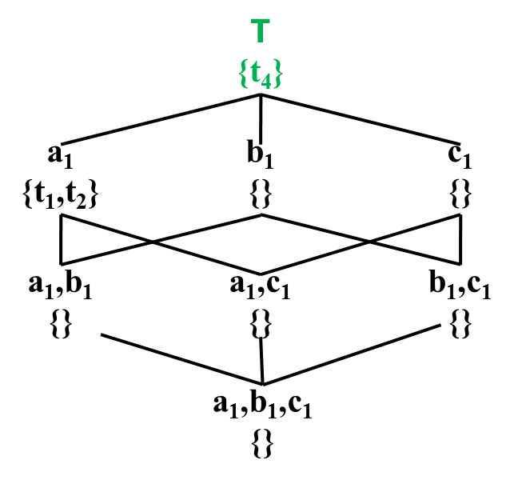
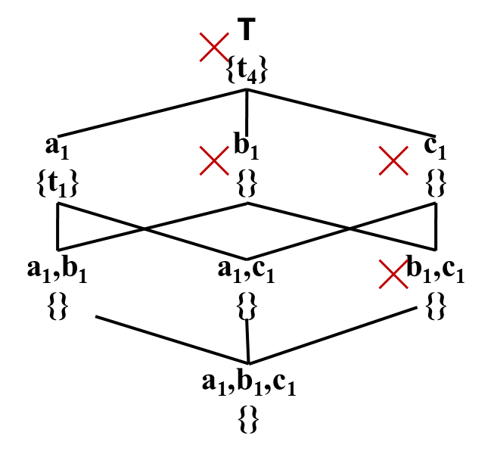
STopDown
id | d₁ | d₂ | d₃ | m₁ | m₂
t₁ | a₁ | b₂ | c₂ | 10 | 15
t₂ | a₁ | b₁ | c₁ | 15 | 10
t₃ | a₂ | b₁ | c₂ | 17 | 17
t₄ | a₂ | b₁ | c₁ | 20 | 20
t₅ | a₁ | b₁ | c₁ | 11 | 15
Comparison with t₄ is skipped
id | d₁ | d₂ | d₃ | m₁ | m₂
t₁ | a₁ | b₂ | c₂ | 10 | 15
t₂ | a₁ | b₁ | c₁ | 15 | 10
t₃ | a₂ | b₁ | c₂ | 17 | 17
t₄ | a₂ | b₁ | c₁ | 20 | 20
t₅ | a₁ | b₁ | c₁ | 11 | 15
Notes:
While comparing t₄ with t₅ in TopDown, as we can see that in attribute m₂ the value of t₄ is larger than t₅. If we consider m₂ as subspace, then t₄ will dominate t₅ in lattice intersection. Based on computation over full space, we can prune lattice intersection in {m₂}, now comparison with t₄ is skipped.

Slide 62
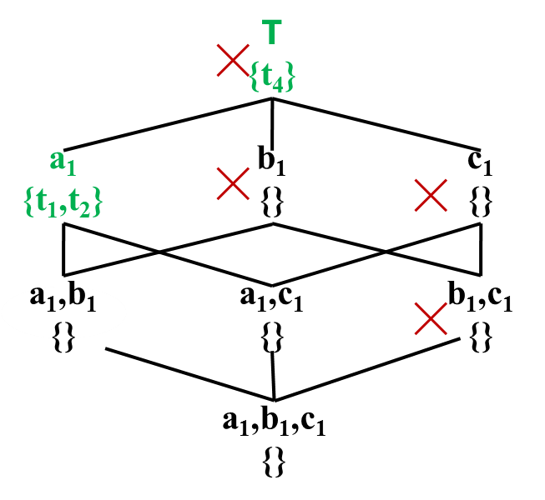
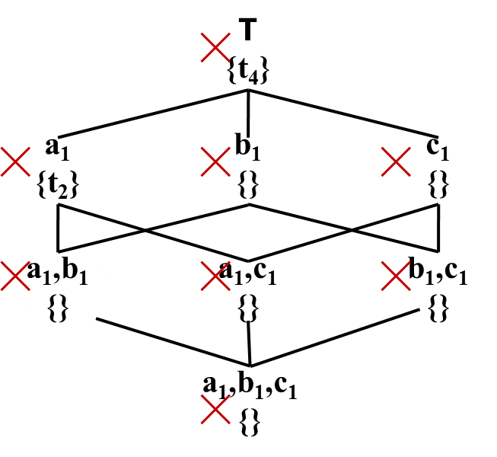
STopDown
id | d₁ | d₂ | d₃ | m₁ | m₂
t₁ | a₁ | b₂ | c₂ | 10 | 15
t₂ | a₁ | b₁ | c₁ | 15 | 10
t₃ | a₂ | b₁ | c₂ | 17 | 17
t₄ | a₂ | b₁ | c₁ | 20 | 20
t₅ | a₁ | b₁ | c₁ | 11 | 15
Comparisons with t₂ & t₄ are skipped
id | d₁ | d₂ | d₃ | m₁ | m₂
t₁ | a₁ | b₂ | c₂ | 10 | 15
t₂ | a₁ | b₁ | c₁ | 15 | 10
t₃ | a₂ | b₁ | c₂ | 17 | 17
t₄ | a₂ | b₁ | c₁ | 20 | 20
t₅ | a₁ | b₁ | c₁ | 11 | 15
Notes:
Similarly, while comparing t₂ with t₅ in TopDown, we can see that in attribute m₁ the value of t₄ is larger than t₅. If we consider m₁ as subspace, then t₂ will dominate t₅ in lattice intersection. Based on computation over full space, we can prune lattice intersection in {m₂}, now comparison with t₂ &t₄ is skipped.
We can skip 3 comparisons here.

Slide 63
Experiment Setup
NBA Dataset
317,371 tuples of NBA box scores from 1991-2004 seasons
8 dimension attributes
7 measure attributes
Weather Dataset
7.8 million tuples of weather forecast from different locations of six countries & regions of UK
7 dimension attributes
7 measure attributes
Notes:
We’ve used two real datasets: NBA and weather. NBA dataset has around 0.3 million tuples of NBA box scores from 1991-2004 seasons. And weather dataset has 7.8 million tuples of weather forecast from different locations of six countries and region of United Kingdom.

Slide 64
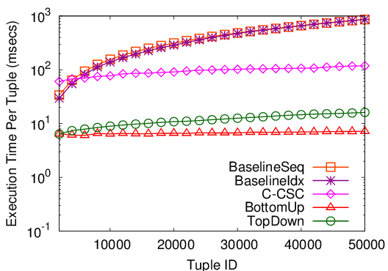
Memory-Based Implementation
NBA Dataset
Maintaining CSC for each constraint causes overhead
(Xia et al. SIGMOD 2006)
Not benefitted by constraint pruning
Notes:
This figure compare per-tuple execution time in memory-based implementation on NBA dataset.
Here, the first two lines represent baselines. The pink one is for C-CSC. The green one is for TopDown and the red one is for BottomUp.
We can see that our methods outperformed the baselines by orders of magnitude and constrained compressed skycube by one order of magnitude as constraint pruning isn’t applicable there.

Slide 65
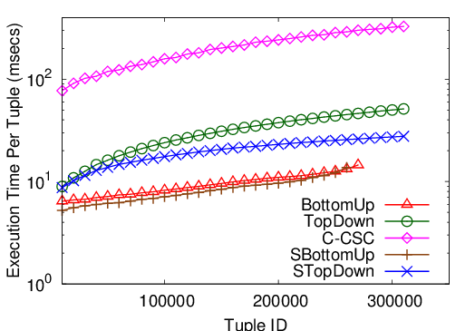
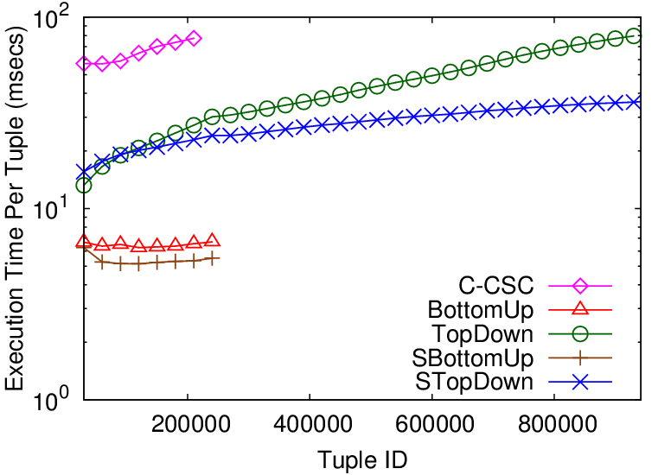
Memory-Based Implementation
NBA Dataset
Weather Dataset
BottomUp/SBottomUp exhausted available JVM heap
memory overflow
TopDown/STopDown was outperformed by BottomUp/SBottomUp
Updating maximal skyline constraints causes overhead
Notes:
These figures compare per-tuple execution time on NBA dataset and weather dataset, respectively.
We can see that bottom-up algorithms exhausted available heap because of memory overflow.
But updating maximal skyline constraints makes top-down algorithms outperformed by bottom-up algorithms.
As a database grows, sooner or later, all algorithms will lead to memory overflow. So, we’ve also implemented on file-based.

Slide 66
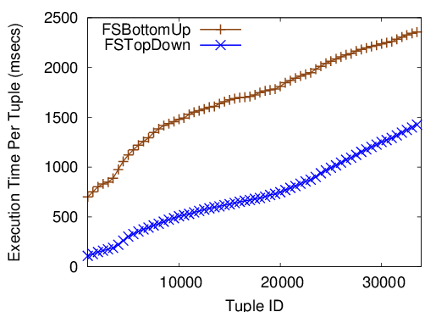
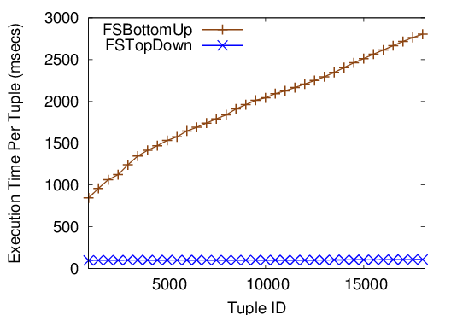
File-Based Implementation
NBA Dataset
Weather Dataset
Each storage of (C,M) is a binary file
While traversing, file-read operation occurs if storage is non-empty: FSTopDown encounters many empty storage
For updating storage, file-write operation occurs: FSTopDown stores fewer tuples
I/O-cost dominates in-memory computation
Notes:
These figures compare per-tuple execution time in file-based implementation on NBA dataset and weather dataset, respectively.
Here, each constraint-measure pair is represented by a binary file.
While traversing, file-read operation occurs if the storage is non-empty. As most of the storages are empty in top-down, it encounters less file-read operations.
File-write operation occurs during updating. As top-down stores fewer tuples, it needs less file-write operations.
Here, top-down is much faster than bottom-up. Though we saw the opposite in memory-based. Because, I/O-cost dominates in-memory computation.

Slide 67
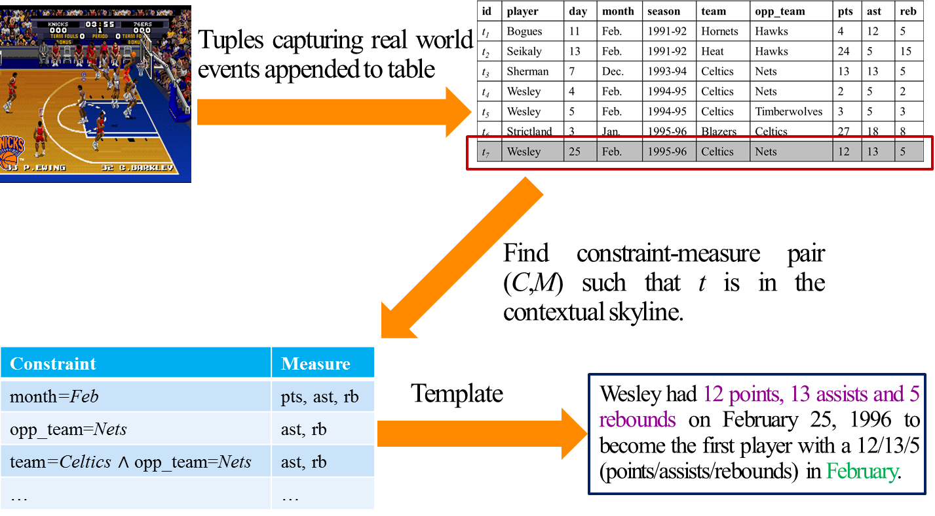
Conclusion
Novel problem of discovering prominent situational facts
Presented Efficient algorithms
Adopted prominence measure to rank
Notes:
Now this is our problem scenario.
We studied a novel problem of discovering prominent situational facts. We presented efficient algorithms. We also adopted a prominence measure to rank the discovered facts.

Slide 68
Ranking Facts
All tuples
Prominence of Fact=
Skyline tuple in same context
Notes:
The prominence of fact is the cardinality ratio of all tuples to skyline tuple in same context.
Let see some examples.

Slide 69
Ranking Facts
id | player | day | month | season | team | opp_team | pts | ast | rb
t₁ | Bogues | 11 | Feb. | 1991-92 | Hornets | Hawks | 4 | 12 | 5
t₂ | Seikaly | 13 | Feb. | 1991-92 | Heat | Hawks | 24 | 5 | 15
t₃ | Sherman | 7 | Dec. | 1993-94 | Celtics | Nets | 13 | 13 | 5
t₄ | Wesley | 4 | Feb. | 1994-95 | Celtics | Nets | 2 | 5 | 2
t₅ | Wesley | 5 | Feb. | 1994-95 | Celtics | Timberwolves | 3 | 5 | 3
t₆ | Strictland | 3 | Jan. | 1995-96 | Blazers | Celtics | 27 | 18 | 8
t₇ | Wesley | 25 | Feb. | 1995-96 | Celtics | Nets | 12 | 13 | 5
(month=Feb,{points,assists,rebounds})=>5/2
Notes:
Here, the total number of tuples is 5 and skyline tuples is 2. Prominence of this fact is is 5/2.

Slide 70
Ranking Facts
id | player | day | month | season | team | opp_team | pts | ast | rb
t₁ | Bogues | 11 | Feb. | 1991-92 | Hornets | Hawks | 4 | 12 | 5
t₂ | Seikaly | 13 | Feb. | 1991-92 | Heat | Hawks | 24 | 5 | 15
t₃ | Sherman | 7 | Dec. | 1993-94 | Celtics | Nets | 13 | 13 | 5
t₄ | Wesley | 4 | Feb. | 1994-95 | Celtics | Nets | 2 | 5 | 2
t₅ | Wesley | 5 | Feb. | 1994-95 | Celtics | Timberwolves | 3 | 5 | 3
t₆ | Strictland | 3 | Jan. | 1995-96 | Blazers | Celtics | 27 | 18 | 8
t₇ | Wesley | 25 | Feb. | 1995-96 | Celtics | Nets | 12 | 13 | 5
(team=Celtics∧opp_team=Nets,{assists,rebounds})=>3/2
Notes:
And for this case it’s 3/2. So, the first one is more prominent as larger ratio indicates rarer event.
Let’s see some discovered situational facts of high prominence extracted by our experiments.

Slide 71
Discovered Facts
Lamar Odom had 30 points, 19 rebounds and 11 assists on March 6, 2004. No one before had a better or equal performance in NBA history.
Allen Iverson had 38 points and 16 assists on April 14, 2004 to become the first player with a 38/16 (points/assists) game in the 2004-2005 season.
Damon Stoudamire scored 54 points on January 14, 2005. It is the highest score in history made by any Trail Blazers.
Notes:
These are some discovered situational facts of high prominence brought out by our experiments.
I’m reading the first one.
We saw statements of this form at the beginning as motivating examples. We brought out similar interesting statements from real dataset.

Slide 72
Future Work
Narrating facts in natural language text
Demo under submission
Notes:
Going forward, we plan to explore several directions, including narrating facts in natural language text. Currently, we have a demo on it under submission.
Thank you!
Do you have any question?

